Slide 1

Chats Layer
Flutter-based Chat Application
Enhancing Communication with Technology
Vaibhav Omar(TL)
Utpal patel
Project Supervisor - Dr. Ankit Verma
Associate Professor

Slide 2


Messaging Apps
Users
Role
Messaging apps have more users worldwide than social networks.
They will play a more significant role in digital information distribution.

Slide 3

Firebase Integration
Realtime Messaging
Firebase enables instant communication between users.
Firestore database securely stores and retrieves chat data.
Firebase enables instant communication between users.
Firestore database securely stores and retrieves chat data.

Slide 4



Chat App Features
Responsive Design
Realtime Messaging
Enhanced Security
Enjoy a fluid chat experience on any device, adapting to screen size.
Exchange text, images, videos with lightning-fast speed.
Implementing end-to-end encryption for privacy and trust.

Slide 5
Software Requirement
Language: Dart
Tools: Flutter , Android Studio
Database: Firestore (GCP)
IDE : Visual Studio Code

Slide 6
Hardware Requirement
Operating System: Windows, Mac
Processor : Intel Core 2 Duo 3.0 GHz
RAM: 4 GB

Slide 7
Enhanced Chat Experience
Realtime messaging allows instant exchange of multimedia content for seamless communication.
1
Advanced features like end-to-end encryption prioritize user security and privacy.
2
Push notifications ensure timely responses, even when app is inactive, enhancing user experience.
3

Slide 8
User Experience Prioritization
Enhanced User Experience
Challenges to Consider
Efficient transmission and display of multimedia content within conversations.
Implementation of push notifications for timely responses even when app not in use.
Incorporation of advanced security features like end-to-end encryption.
Robust authentication mechanisms may lead to a more complex user experience.
End-to-end encryption may affect performance speed in some cases.
Privacy-focused features may require additional user education and onboarding.

Slide 9
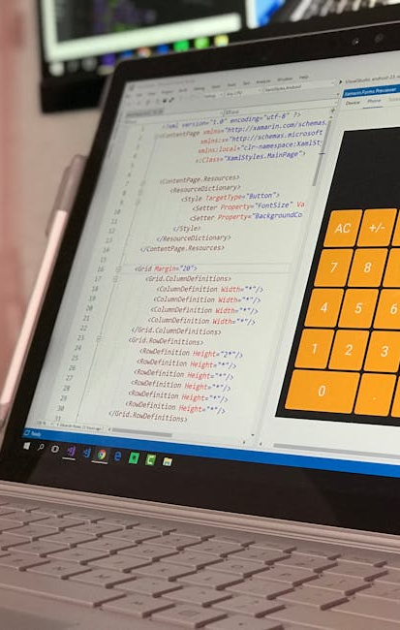
Continuous Improvement and Future Plans
Continuous Improvement
Graphic
Roadmap with milestones highlighting future
Regular updates to enhance user experience.
Incorporation of user feedback for refinement.
Optimization of performance and reliability.

Slide 10


Thank you

